Slide 1
DRAFT High Level Action Plan Independent SWFRS Cultural Review
South Wales Fire and Rescue Authority
Meeting 15 January 2024
Presentation
RAISING AWARENESS
REDUCING RISK

Slide 2
Independent Culture Review Report (ICRR)
Published by South Wales Fire and Rescue Service at 12pm on 03rd January 2024.
The report was published on the Service’s website with an open letter from the Chief Fire Officer.
Communications were distributed to staff on the morning of 03rd January advising of publication later that day.
Email containing ink to the webpage where the report would be published at 12:00
Middle Leader Briefing session at 13:30 – 134 attendees including representative bodies.
All in attendance asked to hold open discussions with and disseminate information to their team members.
82 recommendations made within the report, which were broadly divided into phases;
Initial phase (1-3 months)
Second phase (3-9 months)
Third Phase (9-18 months)
Annually

Slide 3
Findings Themes
Poor Culture and inappropriate behaviours
Standards falling short of that expected and demanded by our communities
Assault, bullying, harassment, discrimination and other inappropriate behaviours
Lack of inclusivity and inappropriate conduct
Negative treatment of female firefighters
Informal networks – existence of a “boys club”
Lack of transparency in promotion processes
A fear of speaking up
Significant improvements required in policies and procedures
Improvements required for disciplinary processes
Inadequate communication at all levels

Slide 4
Findings Themes
A universal proud commitment to service of the community
A usually warm and supportive watch culture
The dedication, passion and commitment of corporate staff
An excellent internal occupational health service
Positive measures to support mental health and the neurodiverse
CFO's Championing of the prevention of violence against women and girls
A greater commitment to Equality, diversity and inclusion

Slide 5
Intent
To create a safe, modern fire and rescue service in South Wales and to ensure everyone is treated with dignity and respect, free from discrimination, bullying, harassment and inappropriate behaviours.

Slide 6
Governance Structure
Fire & Rescue Authority
Culture Review Implementation Committee
Service Review Programme Board
Initial Phase
Policies
Procedures
Values
Standards
Leadership
Training Promotions
Recruitment
Culture
EDI
Communications
Second Phase
Third Phase
Annually

Slide 7
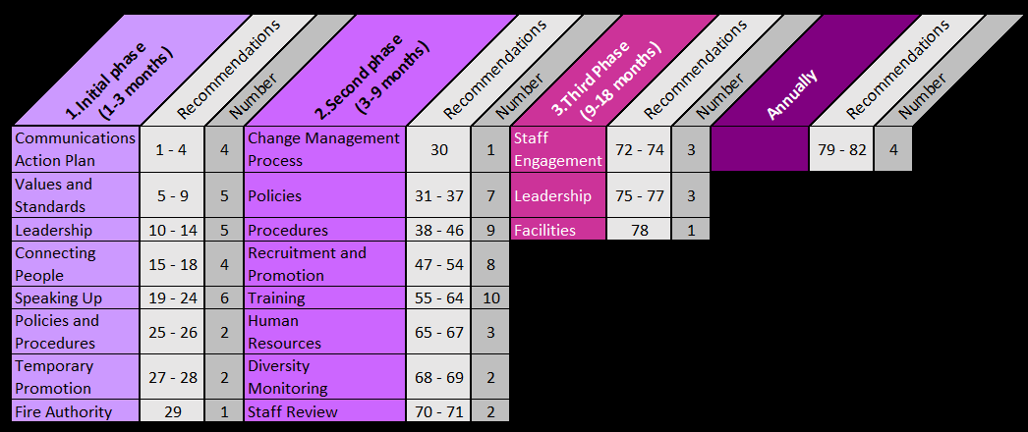
Recommendations Themes

Slide 8
DRAFT High Level Action Plan

Slide 9
1.Initial phase (1-3 months) (i)
Theme | What we are already doing | What we intend to do… | Change / Difference Expect to See
Communications Action Plan | Report published and an open letter from CFO on the Service’s website –signposted all staff and stakeholders to the page prior to the report’s publication. Held a middle leader briefing on the day of the report publication, hosted by the ELT, where a summary of the report’s key findings was provided. There was an opportunity for questions before a briefing note was sent to all middle leaders, with the aim that the contents of this be cascaded to all members of staff. CFO provided a media interview to ITV Wales on the day of the publication. Initiated development of an initial high level action plan for consideration by the Fire and Rescue Authority and our staff. | Host various Q and A sessions with staff during late January to facilitate open two-way discussion with regards to the content of the report, any queries and the Service’s way forward. Create a live Frequently Asked Questions document, where all queries from the staff sessions, along with answers, will be documented in the interest of keeping all staff collectively informed. Create a Culture Review Implementation Committee, with co-opted external stakeholders who are subject matter experts (e.g. domestic abuse advisors, ethnic minority groups, disability groups, and culture experts) | We will have achieved high levels of engagement across all staff groups. Active involvement in shout forums and engagement sessions across the across the Service. Detailed action plan will be developed on a co-creation basis with staff across the Service involved in the working groups and task and finish teams to shape the Service for the future. The monthly Shout Newsletter will have articles sharing the organisations journey through the change programme.

Slide 10
1.Initial phase (1-3 months) (ii)
Theme | What we are already doing | What we intend to do… | Change / Difference Expect to See
Values and Standards | Our current values are referenced within all our procedures and various other organisational documents. They are the foundation of the behaviours we expect all members of staff to display. We have joined an NFCC working group that is specifically looking at a methodology for creating a culture dashboard, using relevant data. | We will review the current suite of values as recommended, with the aim of simplifying them to ensuring that they are impactful. A communications campaign will be devised to enable our leaders to demonstrate clear leadership commitment, including express public declarations (both verbally and in writing) relating to values, equality and diversity, standards and culture. Formalised culture-related training along with bespoke staff communications will be implemented to set and communicate clear behavioural standards, including examples of what will not be tolerated. Devise a culture dashboard for the organisation, which will meet both our own immediate needs and will allow effective benchmarking with other fire and rescue services. The dashboard will include targets and goals. | Renewed and Invigorated Values developed within the Service with staff understanding the meaning and intention of the values as well as how they can be enacted in day to day activities. Staff at all levels of the organisation will display the values in all we do.

Slide 11
1.Initial phase (1-3 months) (iii)
Theme | What we are already doing | What we intend to do… | Change / Difference Expect to See
Leadership | We have set up a Oversight group, which consists of members of the SMT, that monitors progress of all disciplinary cases, grievances, and complaints. All current budget holders are required to complete a “Related party transactions” form annually, where all transactions between the Service and either themselves or those connected to them must be declared in the interest of transparency. | An independent review of the performance of the ELT will be commissioned as recommended. An independent body will be involved in all SMT and ELT appointments as recommended. The eligibility for all roles on both the ELT and SMT to be undertaken by uniformed AND corporate staff will be reviewed prior to the advertisement of new vacancies going forward. All SMT and ELT members will sign conflict of interest declarations, including reference to memberships of other organisations, family relationships or social connections. Declarations will be published online, and updated when a new potential interest arises as recommended. The CFO will participate in disciplinary/grievance/whistle-blowing Oversight Group meetings in the immediate term | Clear and demonstrable scrutiny and transparency around how leaders are selected to their positions and how they subsequently perform in their roles will create an environment where leadership is respected and trusted. Demonstrable ethical leadership at all levels will be key to improving the culture of the organisation.

Slide 12
1.Initial phase (1-3 months) (iv)
Theme | What we are already doing | What we intend to do… | Change / Difference Expect to See
Connecting People | A quarterly staff forum (SHOUT) provides an opportunity for staff to raise concerns and queries among each other, to those presenting chosen topics and often to members of the ELT/SMT in attendance. There are various working groups/staff networks do include staff representatives from a wide range of departments, which therefore ensure key views are considered (e.g., Security Risk Group, Consultation and Engagement Group, Road Risk Group, FireFighters Charity working group etc.) The Principal Officer visits that currently occur on stations were identified as an area of positive performance within the report. | A programme of PO visits for 2024 will be devised to maintain the valuable engagement opportunity that they provide. CFO and another member of the ELT to visit Joint Control Room, and Training Centre, engage with staff there, and write report on their culture and action plan to improve it, as recommended. Engage with staff to gather what the recommended “safe spaces” should look like and how the organisation can support these. | A connected workforce will result in a culture where all members of staff feel empowered, supported and heard. People having the appropriate mechanisms to raise proposed improvements and concerns will lead to a culture where people continue to feel supported to contribute towards the ongoing success of the organisation in delivering our services to our communities.

Slide 13
1.Initial phase (1-3 months) (v)
Theme | What we are already doing | What we intend to do… | Change / Difference Expect to See
Speaking Up | Introduction of the Crimestoppers FRS speak up anonymous reporting line. Resolutions Team (3 Officers) who impartially investigate complaints made Employee Assistance Programme – re-Launched in September 2023. This provides an avenue for staff to discuss any issues and concerns that they do have and to receive support. The role of the Oversight Group does already include grievances and whistleblowing. | The exit interview process has been reviewed and will formally launch in January 2024. The new process involves an initial confidential electronic form to enable the recording of an initial high-level feedback. The option to undertake a face-to-face interview with a member of the HR team is then the next step, removing the interview with the individual’s line manager. Incorporate the importance of staff “speaking up” into the relevant corporate procedures when they are updated. | Reiterating the importance of challenging inappropriate behaviours and providing ample safe and trusted mechanisms to ensure that this can be achieved confidentially or informally will ensure that all examples of inappropriate behaviour can be remedied. Reassurance that all issues raised will be investigated will hopefully eradicate instances where those experiencing poor behaviour choose to keep it to themselves.
Policies and Procedures | The current disciplinary procedure was reviewed by the organisation’s solicitors in recent years and subsequent training regarding the procedure and its implementation was provided to middle leaders. | We will instruct specialist employment lawyers to review policies and procedures, and to assist in drafting a set which are clear and accessible as recommended. The P12 form as it currently stands will be abolished as recommended. | Establishing a suite of policies and procedures that are effective and accessible to all will provide a foundation for establishing the desired behaviours and expectations for all staff. Simplified and accessible procedures will enable staff to explicitly understand what behaviours are acceptable and will clarify all mechanisms available for raising behaviours that contradict this.

Slide 14
1.Initial phase (1-3 months) (vi)
Theme | What we are already doing | What we intend to do… | Change / Difference Expect to See
Temporary Promotion | The organisation does dynamically need to promote individuals in-line with the Service needs, which occasionally is done with urgency and the ongoing need for a promoted individual to remain in post is often due to reasons that cannot be controlled (e.g., ongoing sickness of a substantive post holder). Promotional pathways were reviewed and updated during 2021/2022 – routes to become eligible for promotion have been completely reviewed, ensuring that the process is more efficient and clearer to understand. | The organisation will pause use of temporary promotion for any period in excess of six months wherever possible, as recommended. An immediate review of any current temporary promotion will be undertaken with record of reasons why, exceptionally, it should be permitted to continue beyond six months, and plan to end it. | Minimising the number and duration of temporary promotions will enable the organisation to create a more stable staffing structure, leading to greater consistency of high standards and decision-making. Committing to more permanent staffing appointments through open competitive and thorough promotional processes where successful candidates can aspire to achieving long-term success in post.
Fire Authority |  | We will review the statutory functions of the Fire Authority, as set out in Appendix 2 to the Report, and publish a report on proposals for their use to facilitate these recommendations as recommended. An independent body has been engaged to develop this report to be presented to the Authority. | Formalising the involvement of the Fire Authority in facilitating the recommendations of the report will ensure effective scrutiny and support of our progress.

Slide 15
Approach to Further Phases
Maximise engagement with staff groups and subject matter experts to:
reshape the Service with a co-creation ethos
ensuring meaningful engagement and consultation
present more detailed Initial phase plan to the Culture Review Implementation Committee
co-produce the future across the Service and with partners utilising the social partnership spirit

